Slide 1
DOLE Department Order No. 198 Series of 2018 IRR of RA 11058 “An Act Strengthening Compliance with Occupational Safety and Health Standards and Providing Penalties for Violations Thereof ” Signed: Dec. 6, 2018 Published: Jan. 9, 2019 (Phil. Star) Effective: Jan. 25, 2019
ENGR. MELANIE P. BANAYOS, PME
Supervising LEO
Bureau of Working Conditions

Slide 2
RA 11058
APPROVED : AUGUST 17, 2018
PUBLISHED : AUGUST 22, 2018
EFFECTIVITY : SEPTEMBER 6, 2018
IRR (Dec. 5, 2018) : MUST BE FORMULATED W/N 90 DAYS
AFTER THE EFFECTIVITY OF THE ACT (Sec. 32)
Notes:
Question: 1. Is the law now in effect? Yes
2. In case violations are noted during inspection conducted during the effectivity of the Law, can the
IRR be implemented retroactively? Yes, if the IRR will have a provision for retroactive effect.
Just like Wages Orders passed, the IRR provide for its retroactive effect, to take effect at the time of
the effectivity of the Wage Order.

Slide 3
SALIENT FEATURES

Slide 4
Occupational Safety and Health Standards (OSHS)
Rule 1995: Penal Provision
All violations of the provisions of this Standards shall be subject to the applicable penalties provided for in the Labor Code, PD 442 as amended

Slide 5
Labor Code
Art. 303 (288). Penalties. ..., any violation of the provisions of this Code declared unlawful to be unlawful or penal in nature shall be punished with a fine of not less than P1,000.00 nor more than P10,000.00, or imprisonment of not less than three months nor more than three years, or both such fine and imprisonment at the discretion of the court.

Slide 6
TABLE OF CONTENTS
Sec. 1. Declaration of Policy
Sec. 2. Coverage
Sec. 3. Definition of Terms
Sec. 4. Duties of ER/EE and other Persons
Sec. 5. Workers’ Right to Know
Sec. 6. Workers’ Right to Refuse Unsafe Work
Sec. 7. Workers’ Right to Report Accidents
Sec. 8. Workers’ Right to PPE
Sec. 9. Safety Signage and Devices
Sec. 10. Safety in the Use of Equipment
Sec. 11. OSH Information
Sec. 12. OSH Program
Sec. 13. OSH Committee
Sec. 14. Safety Officer
Sec. 15. OH Personnel and Facilities
Sec. 16. Safety and Health Training
Sec. 17. OSH Reports

Slide 7
Sec. 18. Workers’ Competency Certification
Sec. 19. Workers’ Welfare Facilities
Sec. 20. All Other OSHS
Sec. 21. Cost of Safety and Health Program
Sec. 22. Employer’s Responsibility and Liability
Sec. 23. Visitorial and Enforcement Power of the Secretary of Labor and Employment or his/her duly authorize representatives.
Sec. 24. Payment of Workers during Work Stoppage Due to Imminent Danger
Sec. 25. Delegation of Authority
Sec. 26. Standards Setting Power of the Secretary of Labor and Employment
Sec. 27. Employer’s Compensation Claim
Sec. 28. Incentives to Employers and Workers
Sec. 29. Prohibited Acts and its Corresponding Penalties
Sec. 30. Updated DOLE Computerized Inspection System
Sec. 31. Inter-Government Coordination and Cooperation
Sec. 32. Separability Clause
Sec. 33. Repealing Clause
Sec. 34. Effectivity

Slide 8
Section 1: Declaration of Policy
The state affirms labor as a primary social and economic force, and that a
safe and healthy workforce is an integral aspect of nation building.

Slide 9
Section 2: Coverage
This act shall apply to all establishments, projects and sites, and all other places where work is being undertaken in all branches of economic activity.

Slide 10
Section 2: Coverage
This Rules shall also cover contractors and subcontractors, including those engaged in the projects of the public sector.

Slide 11
Section 2: Coverage
This Rules DO NOT apply to the
public sector.

Slide 12
JOINT ADMINISTRATIVE ORDER NO. 2017-01 (January 31, 2017)
CSC, DOH and DOLE signed the JAO on the National Occupational Health and Safety Policy Framework to guide the key stakeholders in the development, implementation, monitoring and evaluation of Occupational Health and Safety for both the public and private sector workers.

Slide 13
JOINT MEMORANDUM CIRCULAR NO. ____ (Rules and Procedures on OSHS for Public Sector)
High Lights:
Covers all government officials including job orders and contract of services.
CSC to administer and enforce the provisions of the Joint Memo.(Rules 1030, 1040, 1050, 1060, 1070, 1080)
Every government offices or place of employment will be inspected by CSC and DOH, together with the agencies’ and employees’ representative .
Funding needed to support the implementation of the Joint Memo shall be included in the agency’s regular budget.
Inclusion in agencies’ Annual Report their compliance with the Joint Memo.

Slide 14
Section 6: Workers’ Right to Refuse Work
As a preventive measure, the safety officer may, following his/her determination and without fear of reprisal, implement a work stoppage or suspend operations in cases of imminent danger.

Slide 15
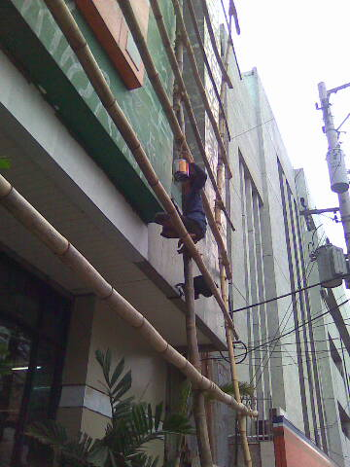

Slide 16
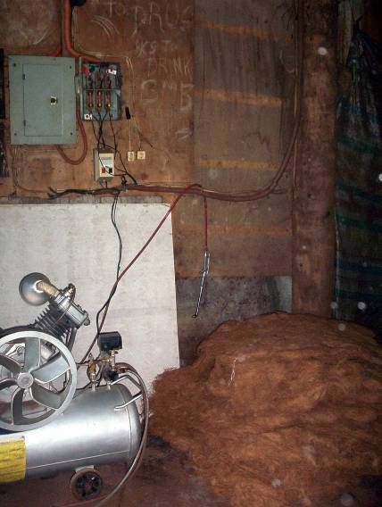
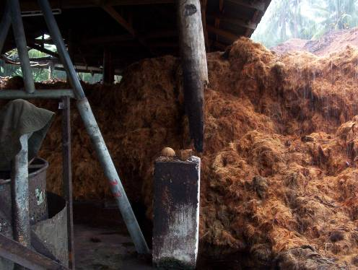
Coco-shavings
Imminent Danger Situation
A broken post which may cause roof collapse
Presence of coco-shavings / fibers
near electrical connections and
machine.

Slide 17
Sec. 29. PROHIBITED ACTS & ITS CORRESPONDING PENALTIES
Any willful failure or refusal of an employer, contractor or subcontractor to comply with the following OSH standards or with a compliance order issued by the Secretary of Labor and Employment or his/her authorized representative shall be penalized of the administrative fines computed on a per day basis until full compliance.

Slide 18
Four (4) Prohibited Acts
Willful failure to comply with the required OSHS;
Willful refusal to comply with the required OSH;
Willful failure to comply with a CO issued;
Willful refusal to comply with a CO issued.

Slide 19
ROUTINE INSPECTION
Assignment of establishments
Verification of Compliance
Notice of Results
Opportunity for corrective action
Technical assistance leading to compliance
Period of correction
10 days – GLS
max 90 days –OSHS
1 day – imminent danger
3 days – PPE
Note: For CI, the correction period is w/n 10 days (Rule X, Sec. 1 of D.O. 183-17)

Slide 20
Preparation of Action Plan (Rule V, Sec. 3(f), D.O. 183-17)
“f. Formulation and Submission of Action Plan.-
During the conduct of Routine Inspection, the Labor Inspector shall state in the Notice of Results the summary of violations, the corresponding remediations to be made, and the deadline when the said remediation should be made or completed. The establishment with OSHS violations shall prepare an Action Plan, with the assistance of the Labor Inspector, to remediate the violations with a copy thereof furnished to both management and employees’ representative for unorganized establishment or the Sole and Exclusive Bargaining Agent in organized establishment.”

Slide 21
PROHIBITED ACTS AND ITS CORRESPONDING PENALTIES
Failure or refusal to comply with OSH standards or compliance order shall be deemed willful when done voluntarily, deliberately and intentionally.

Slide 22
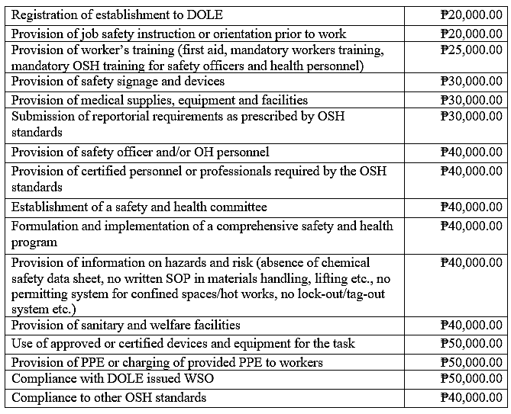

Slide 23
PROHIBITED ACTS AND ITS CORRESPONDING PENALTIES
An employer, contractor or subcontractor who is found to have repeatedly violated the same prohibited act shall be penalized of the corresponding fine plus an additional fine equivalent to fifty percent (50%) thereof for every instance of repeat violation.

Slide 24
PROHIBITED ACTS AND ITS CORRESPONDING PENALTIES
If any of the following acts is present and there is non-compliance, the penalty of one hundred thousand pesos (₱100,000.00) administrative fine shall be imposed separate and in addition to the daily administrative fine imposed above:
Repeated obstruction, delay or refusal to provide the SecLab or any of its authorized representatives access to the covered workplace or refusal to allow access to relevant records and documents necessary in determining compliance with OSH standards;
Misrepresentation in relation to adherence to OSH; or
Making retaliatory measures such as termination of employment, refusal to pay, reducing wages and benefits or in any manner discriminates against any worker who has given information relative to the inspection being conducted.

Slide 25
PROHIBITED ACTS AND ITS CORRESPONDING PENALTIES
When the violation exposes the worker to death, serious injury or serious illness, the imposable penalty shall be one hundred thousand pesos (₱100,000.00)
Should there be 2 or more be non-compliances, all penalties shall be imposed; provided that the total daily penalty shall not exceed one hundred thousand pesos (₱ 100,000.00)
The penalties shall be computed on a per day basis until full compliance reckoned from the date of the notice of violation or service of the compliance order to the employer without prejudice to the filing of a criminal or civil case in the regular courts, as the case may be.
The RD shall, after due notice and hearing, impose the appropriate administrative fines taking into consideration the damage or injury caused and risk involved including the severity and frequency of the OSH violations and size of the establishment.
Fines collected pursuant to this Rules shall be utilized for the operation of OSH initiatives incentivizing qualified employers and workers in recognition of their efforts towards ensuring compliance with OSH.

Slide 26
D.O. 183-17 REVISED RULES ON THE ADMINISTRATION AND ENFORCEMENT OF LABOR LAWS PURSUANT TO ARTICLE 128 OF THE LABOR CODE, AS RENUMBERED
Finding of Violations on OSHS shall be indicated in the Notice of Results (NR)
Employer shall prepare an Action Plan to be assisted by the Labor Inspector, indicating therein the period within which to comply (Rule V (f), D.O. 183-17)
After the laps of the period and no compliance were made, a hearing shall proceed
Compliance Order shall be issued if still no compliance were made
Under the New OSH Law, Administrative Fine shall be imposed

Slide 27
REPEALING CLAUSE
All rules and regulations or other issuances or parts thereof which are inconsistent with this Rules are hereby modified or repealed.

Slide 28
All Other Occupational Safety and Health Standards
All employers, contractors or subcontractors, if any, shall comply with other occupational safety and health standards as provided for in the
1978 DOLE Occupational Safety and Health Standards, as amended.

Slide 29
Section 14: Safety Officer
Category | Prescribed Training | Minimum Experience
Safety Officer 1 (SO1) | Mandatory (8)-hours orientation course; Two hours trainers’ training. | -
Safety Officer 2 (SO2) | Mandatory 40-hour basic OSH training course applicable to the industry. | -
Safety Officer 3 (SO3) | Mandatory 40-hour basic training; Additional 40-hours of advance/specialized OSH training Other requirements as prescribed by the OSH Standards. | At least (2) years of experience in OSH

Slide 30
Section 14: Safety Officer
Category | Prescribed Training | Minimum Experience
Safety Officer 4 (SO4) | Mandatory 40-hour basic training; Additional 80-hours of advance/specialized OSH training; An aggregate of 320-hours of OSH related training or experience (additional training may be converted to years of experience where 80-hours of training may be equal to 1-year and vice versa; Other requirements as prescribed by the OSH Standards. | Actual experience as SO3 for at least (4) years.

Slide 31
Section 14: Safety Officer
Number of Workers | Low Risk | Medium Risk | High Risk
1-9 | (1) SO1 | (1) SO1 | (1) SO2
10-50 | (1) SO1 | (1) SO2 | (1) SO3
51-99 | (1) SO2 |  | (1) SO2 & (1) SO3
100-199 |  | (1) SO2 & (1) SO3
200-250 | (2) SO2 or (1) SO3 |  | (2) SO3
251-500 | (2) SO2 & (1) SO3 | (2) SO3 | SO2 & SO3
501-750
751-1000 | (2) SO3
Every additional 250 or fraction thereof | - | - | +(1) SO3 or SO4
Every additional 500 or fraction thereof | +(1) SO3 | +(1) SO3 or SO4 | -

